Slide 1
Algorithms PLANNING & REFINEMENT
Visual Basic

Slide 2
Table OF contents
Lecture context
WHY SHOULD I PLAN
WHAT IS AN ALGORITHM?
Flowcharting
Developing algorithms
Representing algorithms
Flowchart symbols
Modularity & structure
Top-down & Top Level design
Real World Algorithms

Slide 3
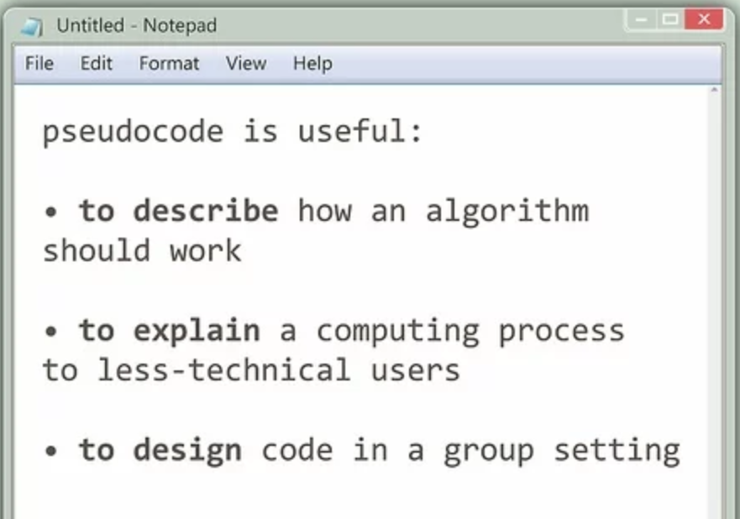
Lecture context
Be familiar with pseudo code and flowcharts
Understand the fundamentals of algorithmic design.
Appreciate the importance of careful planning and modularity
Know how to use top-down and stepwise refinement design techniques
Notes:
Must remember by heart these 4 points, though not scope of course, you will consciously and subconsiously use this programming paradigm.

Slide 4
Lecture context
As with all engineering tasks, good design requires good understanding of the problem and solution, as well as good planning and management of the project.
It is also important to communicate ideas well whether in the form of an engineering drawing or an algorithm/flowchart.
This lecture looks at some rudimentary software design and planning techniques that will make writing actual code much easier and will be required and assessed during class.
Notes:
Must remember by heart these 4 points, though not scope of course, you will consciously and subconsiously use this programming paradigm.

Slide 5

WHY SHOULD I PLAN
Would you ask a technician to make a component without engineering drawings?
Or without tolerances?
So why try to write a program without planning and documentation (algorithm)?
Students often attempt to code without really understanding the problem or flowcharting.
Result? many errors, wasted time, stress, anger, frustration, and low marks of course.
Notes:
Must remember by heart these 4 points, though not scope of course, you will consciously and subconsiously use this programming paradigm.

Slide 6
Can YOU MAKE THIS
Notes:
Must remember by heart these 4 points, though not scope of course, you will consciously and subconsiously use this programming paradigm.

Slide 7
OR THIS
Notes:
Must remember by heart these 4 points, though not scope of course, you will consciously and subconsiously use this programming paradigm.

Slide 8
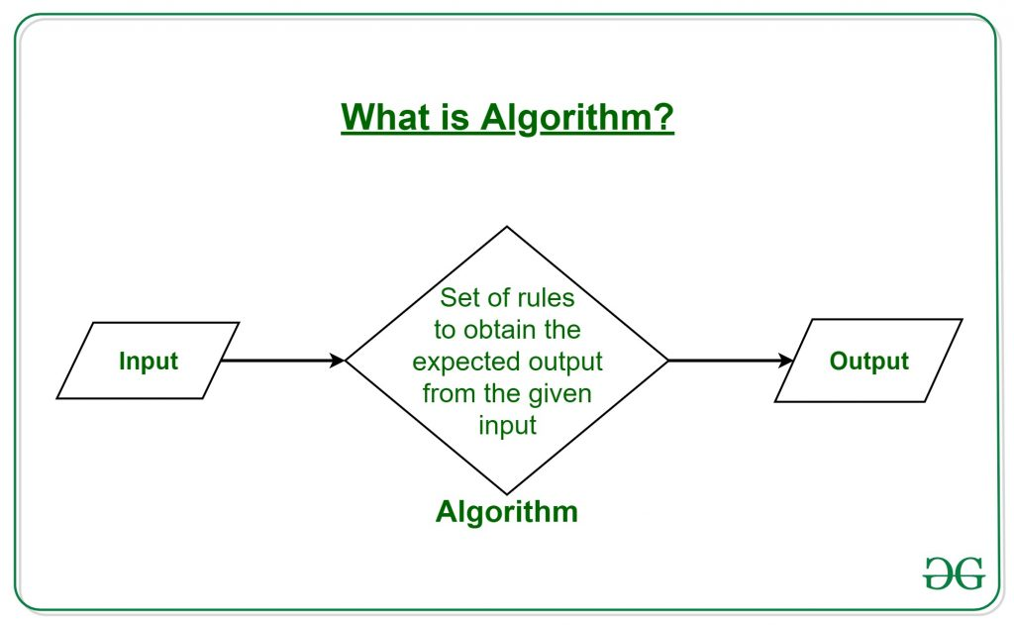
WHAT IS AN ALGORITHM?
A precise set of instructions which specifies exactly how a task is done
Instructions must (nearly) always be carried out in correct sequence
They are always language independent
May often be changed slightly without generating problems – beware, computers do EXACTLY as they are TOLD (not mind readers)
Notes:
Must remember by heart these 4 points, though not scope of course, you will consciously and subconsiously use this programming paradigm.

Slide 9
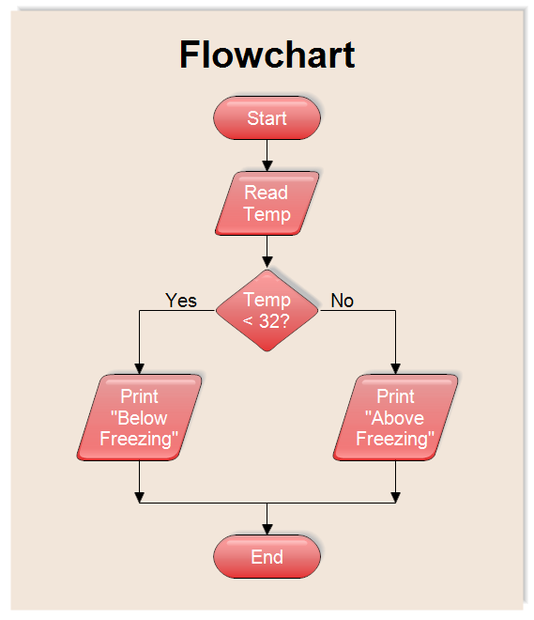
Flowcharting
Some rules before flowcharting
Fully understand the problem
Be clear what information you have and what information you are trying to discover
Pay attention to units and conversions
Draw a picture/sketch if possible to get problem clear in your head
Work backwards sometimes – what is the last step required to get the required answer?
look for repeated operations (iteration)
Notes:
Must remember by heart these 4 points, though not scope of course, you will consciously and subconsiously use this programming paradigm.

Slide 10
Flowcharting
Some rules before flowcharting
Fully understand the problem
Be clear what information you have and what information you are trying to discover
Pay attention to units and conversions
Draw a picture/sketch if possible to get problem clear in your head
Work backwards sometimes – what is the last step required to get the required answer?
look for repeated operations (iteration)
Notes:
Must remember by heart these 4 points, though not scope of course, you will consciously and subconsiously use this programming paradigm.

Slide 11
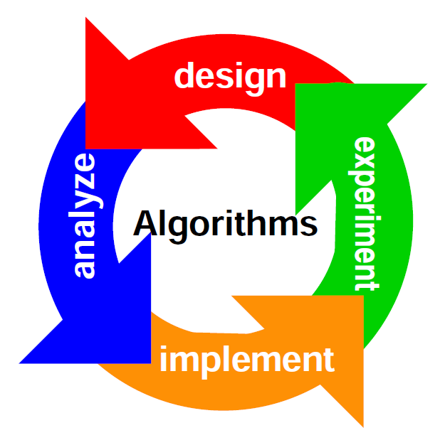
Developing algorithms
Develop one step at a time (stepwise refinement) to produce a fully detailed and complete design
Precise, rigorous, complete, algorithm development is essential for easy programming and fewer bugs
Fully complete each step/stage before moving on to the next; break solution/code into small sections
Never make changes without clearly knowing why or you simply introduce more problems!!
If mistakes are found go back and correct from earlier stage of design (algorithm representation)
Notes:
Must remember by heart these 4 points, though not scope of course, you will consciously and subconsiously use this programming paradigm.

Slide 12
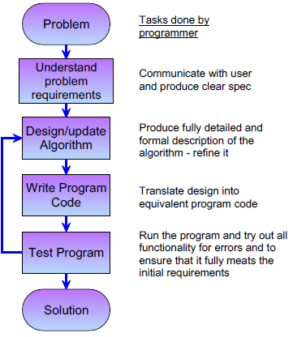
Developing algorithms
Development cycle
Coding take up only 20% of the task
80% is understanding planning and thinking before writing any code
Notes:
Must remember by heart these 4 points, though not scope of course, you will consciously and subconsiously use this programming paradigm.

Slide 13
Representing algorithms
Flowchart: clear graphical representation of Algorithm
Pseudocode: Structured English using ‘English-Like’ words to describe algorithm
Flowchart much better for larger designs – but need to break large tasks down
Goal is to produce stepwise refined language-independent, clear process description
Notes:
Must remember by heart these 4 points, though not scope of course, you will consciously and subconsiously use this programming paradigm.

Slide 14
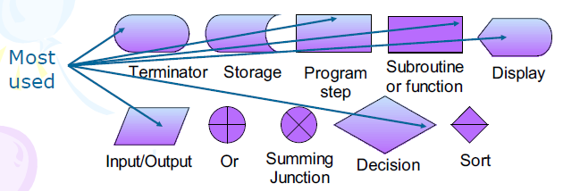
Flowchart symbols
Symbols representing tasks joined with arrows indicating flow direction
Computer generation or pencil on paper
Notes:
Must remember by heart these 4 points, though not scope of course, you will consciously and subconsiously use this programming paradigm.

Slide 15
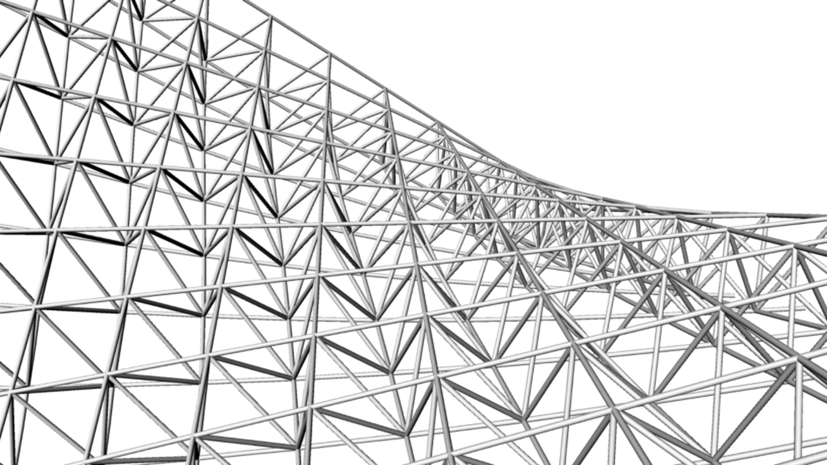
Modularity & structure
Modularity is a VERY important technique
Build algorithm up from small sections: easy flowcharting, programming, testing, and debugging
Split the problem up into small sections and program each as a module (procedures - future lecture)
There are three basic programming structures available for use in our modules: - Sequence - Do this, then this, then this, then…. - Selection - Do this, or this, or this and this, or…. - Iteration - Do this same thing over and over again….
Notes:
Must remember by heart these 4 points, though not scope of course, you will consciously and subconsiously use this programming paradigm.

Slide 16
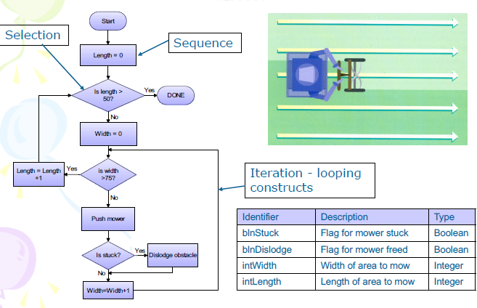
FLOWCHART EXAMPLE

Slide 17
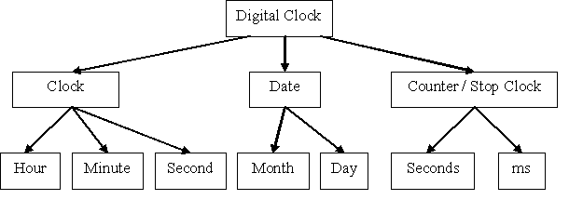
Top-down design
Must fully understanding nature and complexity of the problem first
Initially describe algorithm’s functionality at high level of abstraction using basic, broad, steps
Refine each step individually by adding increasing levels of detail; stepwise refinement
A fully refined design is detailed to a level that requires a simple step to translate into ANY high-level programming language
Good example of a top-down design
Notes:
Must remember by heart these 4 points, though not scope of course, you will consciously and subconsiously use this programming paradigm.

Slide 18
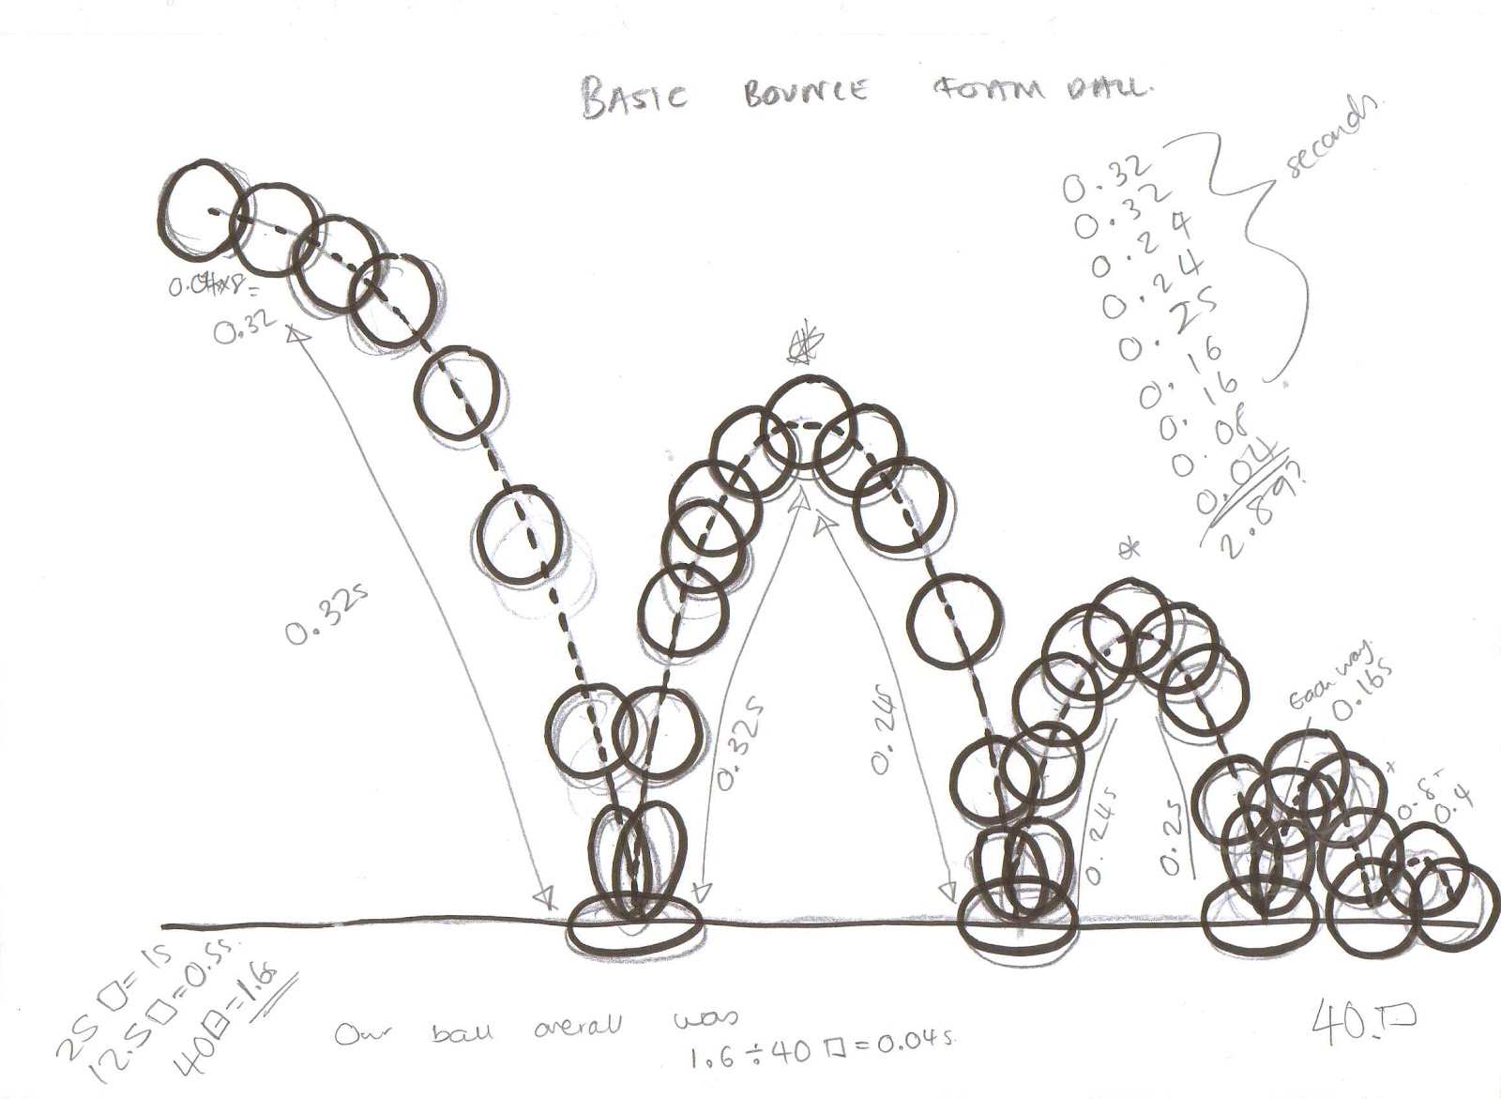
Top-down example
Problem: How far does a ball fall in 1, 2, 3, and 4s if dropped? Neglect all forces except gravity. How far does it fall in each 1s interval?
Known information: Stationary at T=0, accelerates 9.81m/s2, no other forces
Need to know: distance travelled each second
a = 9.81 m/s2
Integration: v= ʃ 9.81m/s2 dt = 9.81m/s
Integration: d= ʃ 9.81m/s dt = 0.5*9.81*t2 m
Notes:
Must remember by heart these 4 points, though not scope of course, you will consciously and subconsiously use this programming paradigm.

Slide 19
Top Level design
Describe algorithm with a very basic set of steps
Notes:
Must remember by heart these 4 points, though not scope of course, you will consciously and subconsiously use this programming paradigm.

Slide 20
Top level design
Stepwise refine 1st time
Increase level of detail in distances Section
Closer to a workable design realisation
Notes:
Must remember by heart these 4 points, though not scope of course, you will consciously and subconsiously use this programming paradigm.

Slide 21
Top level design
Stepwise refine 2nd time
Increase level of detail in interval Section
Notes:
Must remember by heart these 4 points, though not scope of course, you will consciously and subconsiously use this programming paradigm.

Slide 22
Top level design
Final Refinement
This problem is suited to an iterative solution
This is a workable solution that is easily programmed
NOTE language independent!!
Notes:
Must remember by heart these 4 points, though not scope of course, you will consciously and subconsiously use this programming paradigm.

Slide 23
Top level design
Solution for 2nd refinement
Notes:
Must remember by heart these 4 points, though not scope of course, you will consciously and subconsiously use this programming paradigm.

Slide 24
Top level design
Solution for final refinement
Notes:
Must remember by heart these 4 points, though not scope of course, you will consciously and subconsiously use this programming paradigm.

Slide 25
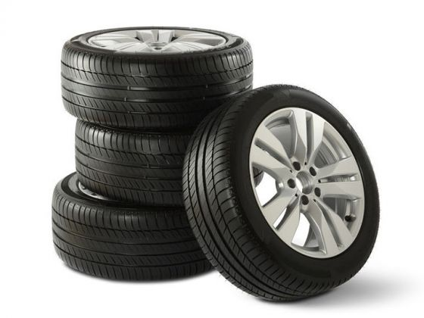
REAL World algorithms
Algorithms are not just for programming
Changing a car tyre:
I. Apply handbrake
II. Get jack and spare tyre from boot
III. Loosen wheel nuts
IV. Insert jack and raise car
V. Remove nuts and wheel
VI. Put on spare tyre and nuts
VII. Lower car and remove jack
VIII. Tighten wheel nuts
IX. Put Jack and punctured tyre away
Notes:
Must remember by heart these 4 points, though not scope of course, you will consciously and subconsiously use this programming paradigm.

Slide 26
REAL World algorithms
What about changes to an algorithm?
- Omit steps or change order in wheel change
algorithm? Disaster!
Change steps 4 & 5 around! Miss out 6!
Computers are really stupid, not intelligent
- They do EXACTLY as they are told – not
what the programmer intended!
Get algorithm RIGHT before coding
- The work is algorithm design, not the coding
Notes:
Must remember by heart these 4 points, though not scope of course, you will consciously and subconsiously use this programming paradigm.

Slide 27

REAL World algorithms
Example top down design
Understand problem
- How to convert ˚C to ˚F?
- From research ((Centigrade*9)/5)+32
- Consider interface design at this point
- Care during algorithm development: determine
order of execution of steps
Notes:
Must remember by heart these 4 points, though not scope of course, you will consciously and subconsiously use this programming paradigm.

Slide 28
REAL World algorithms
Top-Level design (pseudocode)
1 Read in centigrade value
2 Calculate Fahrenheit value
3 Display Fahrenheit value
Now stepwise refine the algorithm:
- What type of values will be read in/out?
- How will we store them? – create a data table
- How do we perform the conversion?
Notes:
Must remember by heart these 4 points, though not scope of course, you will consciously and subconsiously use this programming paradigm.

Slide 29
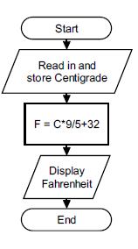
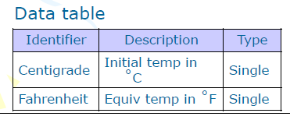
REAL World algorithms
Stepwise refined design
1 Read in centigrade value
2.1 Set Fahrenheit to (C*9/5 + 32)
3 Display Fahrenheit value
Now stepwise refine the algorithm:
- What type of values will be read in/out?
- How will we store them? – create a data table
- How do we perform the conversion?
Notes:
Must remember by heart these 4 points, though not scope of course, you will consciously and subconsiously use this programming paradigm.

Slide 30
Exercise (10 – 15 mins)
Design a Centigrade to Fahrenheit convertor
There is no need to design it vice-versa
Popular exam question to test competency
Formula: Fahrenheit = Centigrade * 9/5+32
Notes:
Must remember by heart these 4 points, though not scope of course, you will consciously and subconsiously use this programming paradigm.

